Slide 1
Welcome to the St. Louis UserCon!

Slide 2
Try Before You Buy! Ways to try out new VMware by Broadcom products before you renew
Scan QR Code for download
Link to the presentation

Slide 3
Who am I?
Matt Heldstab
10x VMware vExpert – Double VCP (Datacenter and Desktop)
Systems Engineer – Minnesota State Colleges and Universities
VMUG Leader – Minneapolis, MN
Current VMUG Vice President
Contact: mheldstab@vmug.com -- @mattheldstab on X

Slide 4
What we will cover
Level-set – What are the new licensing levels?
How to get the software?
Setting up the test environment
Deploying VCF (consolidated architecture)
Cloud Builder Appliance
Filling out the Deployment Parameters Workbook
Executing the Bringup using Cloud Builder
Deploying an Edge Cluster
Deploying Application Virtual Networks
Deploying Aria Lifecycle Manager
Day 2 Operations
Connect to your VMware Account / using an offline repository
Installing Bundle Updates
Expanding your Management Domain

Slide 5
How to get the software
VMware’s Website Start an evaluation (one-time)
Install the software without a license (60 day evaluation)
VMUG Advantage – EvalExperience – 365 day evaluations - $210
Talk to the VMUG Staff for a 10% Discount today!
vExpert – More info at https://vexpert.vmware.com
Other Deployment Mechanisms
William Lam’s Deploy Script
Holodeck 2.0

Slide 6
What are the differences between some of the
new products offered by VMware by Broadcom

Slide 7
VCF
VMware Cloud Foundation

Slide 8
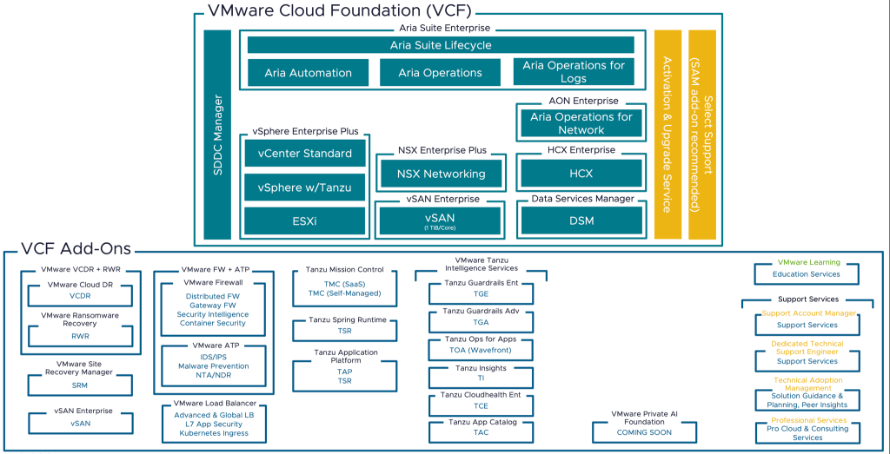
Entire feature list available at:
https://www.vmware.com/content/dam/digitalmarketing/vmware/en/pdf/docs/vmw-datasheet-vsphere-product-line-comparison.pdf

Slide 9
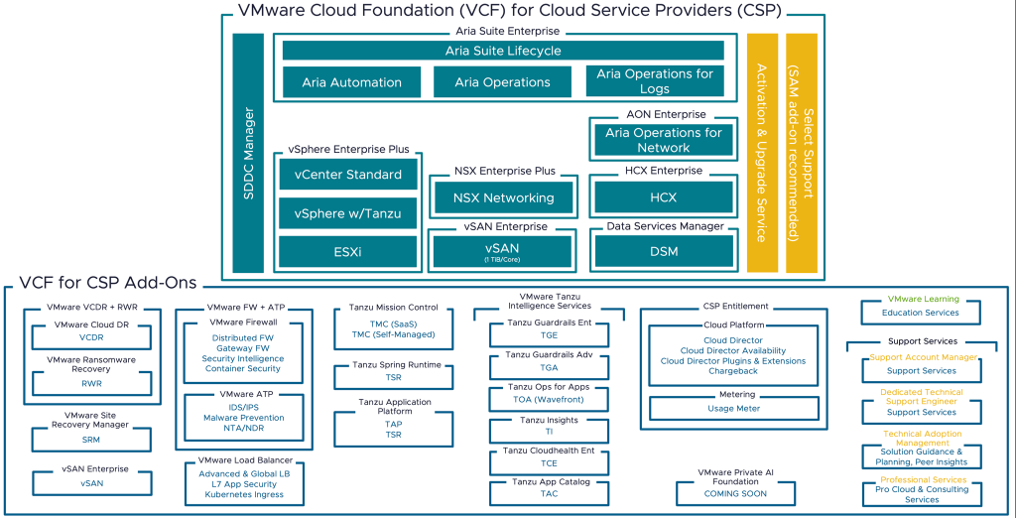
Entire feature list available at:
https://www.vmware.com/content/dam/digitalmarketing/vmware/en/pdf/docs/vmw-datasheet-vsphere-product-line-comparison.pdf

Slide 10
VVF
VMware vSphere Foundation

Slide 11
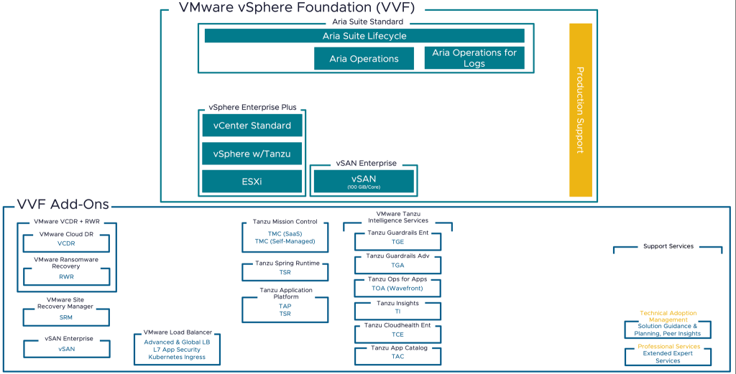
Entire feature list available at:
https://www.vmware.com/content/dam/digitalmarketing/vmware/en/pdf/docs/vmw-datasheet-vsphere-product-line-comparison.pdf
Many vSAN customers
Will need to purchase the
1TiB add-on to license their
cluster.

Slide 12
VVS
VMware vSphere Standard

Slide 13
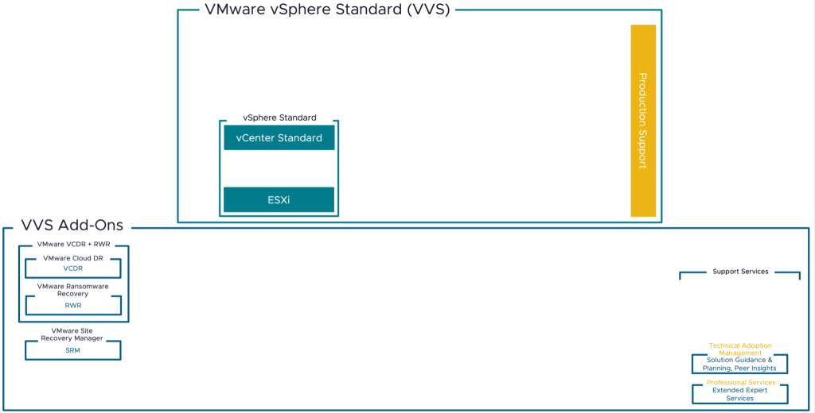
Entire feature list available at:
https://www.vmware.com/content/dam/digitalmarketing/vmware/en/pdf/docs/vmw-datasheet-vsphere-product-line-comparison.pdf
Allows for multiple
vCenter Instances
Does not include:
Distributed Switches
Distributed Resource Scheduler (DRS)
VM Encryption
Storage DRS
Storage and Network I/O Controls
Host Profiles
Distributed Power Management
Proactive HA
vSphere Persistent Memory
Includes:
VMware HA
VMware VMotion
VMware FT (1-2 vCPU only)
Storage VMotion
Hybrid Linked Mode
Content Libraries
Virtual Volumes (VVOLs)
TPM 2.0 and Virtual TPM
Enhanced vMotion Compatibility (EVC)
vCenter Native Backup
vSphere Replication

Slide 14
VVEP
VMware vSphere Essentials Plus

Slide 15
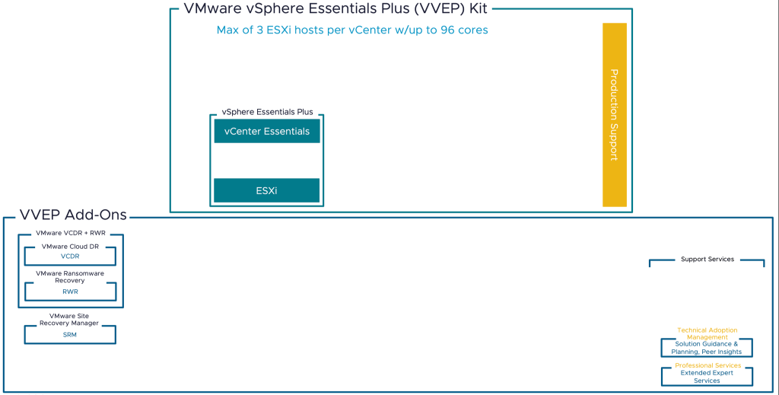
Entire feature list available at:
https://www.vmware.com/content/dam/digitalmarketing/vmware/en/pdf/docs/vmw-datasheet-vsphere-product-line-comparison.pdf
You cannot manage other ESXi hosts
With vCenter Essentials (VCF, VVF, VVS)
Pay for all 96 cores
(3 hosts, 2x 16 core
or 1x 32 core)

Slide 16
Let’s Chat about the newer products
VCF and VVF

Slide 17
If I purchase VCF, do I need to run the entire Software-Defined Datacenter?
NO. Purchasing VCF gives you the software keys for products such as:
vSphere
vCenter
NSX-T
VSAN (with up to a 1TiB per physical core entitlement)
Aria Suite – etc…

Slide 18
How can I get the software to try it out?
VMware Evaluation (log in via your vmware.com portal)
VMUG Advantage (EvalExperience – 365 day licenses)
VMware vExpert (level-up in the community!)

Slide 19
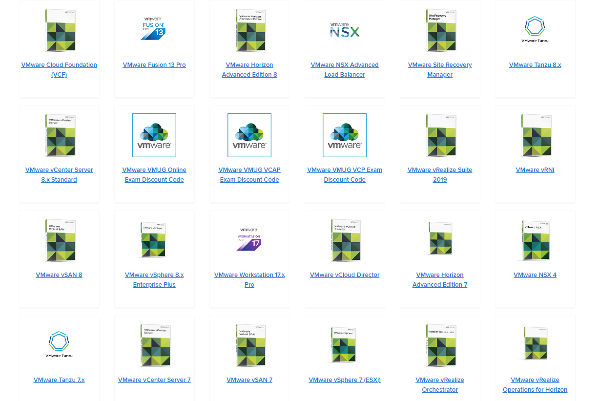
VMUG Advantage
EvalExperience
365-day Eval Licenses for
The products you see here
Non-production use only

Slide 20
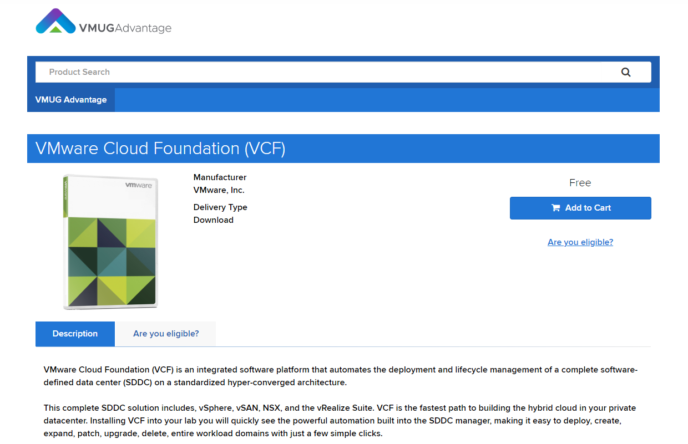

Slide 21
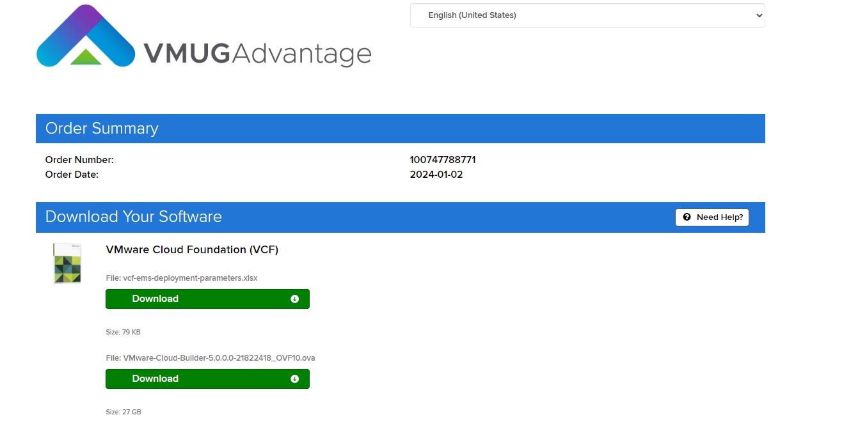

Slide 22
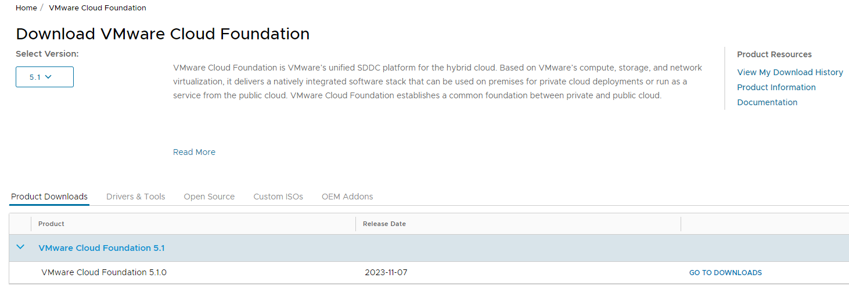

Slide 23
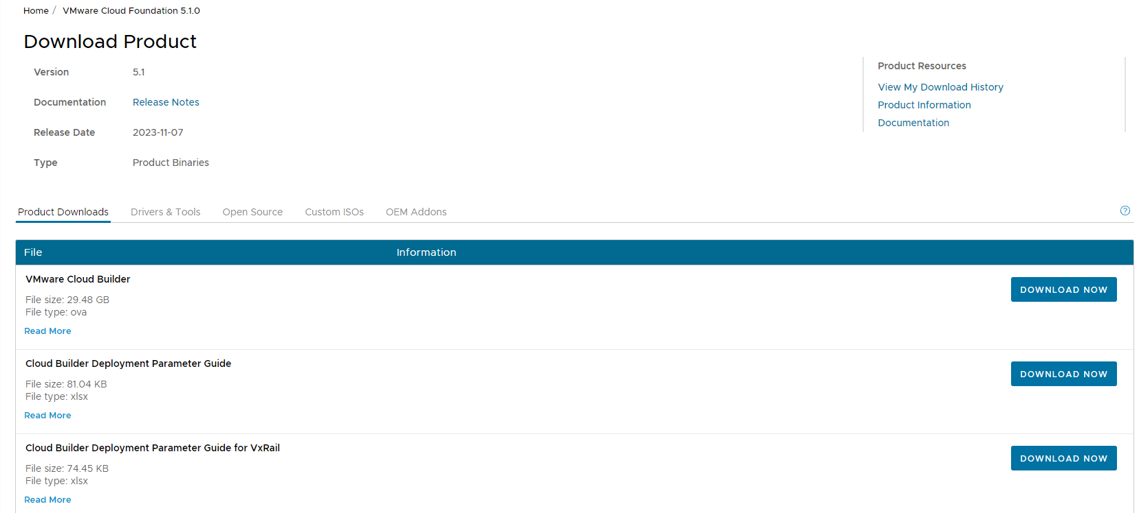
← 29GB DOWNLOAD!
Each major version of Cloud Builder has its own Parameter Guide Spreadsheet

Slide 24
Important Prerequisites:
Make sure NTP is functional (NTP servers, ESXi hosts, Cloud Builder Appliance)
DNS Forward and Reverse for all hosts is functional
If things blow up, have an easy way to revert
Cloud Builder Appliance Snapshot
Nested ESXi Hosts

Slide 25
Setting up a test environment
Nested Environment
At least 24 cores (48 logical)
Minimum of 386GB RAM
Find a server that can give you at least 8 – 300GB SSD drives – Dedicate two drives per virtual ESXi host
Optionally, add some extra disk to host the Physical ESXi host boot and dependent infrastructure (DNS, Cloud Builder VM, Linux Utility VM, Certificate Authority, etc)
12 vCPU, 96GB RAM per virtual ESXi host (DON’T SKIMP ON CPU)
Each VM should have three disks – I choose a 32GB Boot, 100GB Cache and 250GB Capacity disk (VSAN OSA)

Slide 26
Setting up a test environment
Network Infrastructure
Ubiquiti Dream Machine Pro
Ubiquiti Unifi 10Gb Aggregation Switch
Alternatively, you can use a managed switch that does 802.1q VLAN’s and a software firewall appliance.
VLAN’s that I have built
VLAN for ESXi hosts and vCenter
VLAN for critical infrastructure (Domain Controllers/DNS
VLAN for VMotion
VLAN for VSAN
VLAN for NSX Host TEP’s (DHCP-enabled)
VLAN for NSX Edge TEP’s
VLAN for First NSX Edge Node Tier-0 Uplink
VLAN for Second NSX Edge Node Tier-0 Uplink
VLAN for NSX Region-A AVN Applications (Aria for Logs)
VLAN for NSX X-Region AVN Applications (Aria Ops, Auto, Identity)

Slide 27
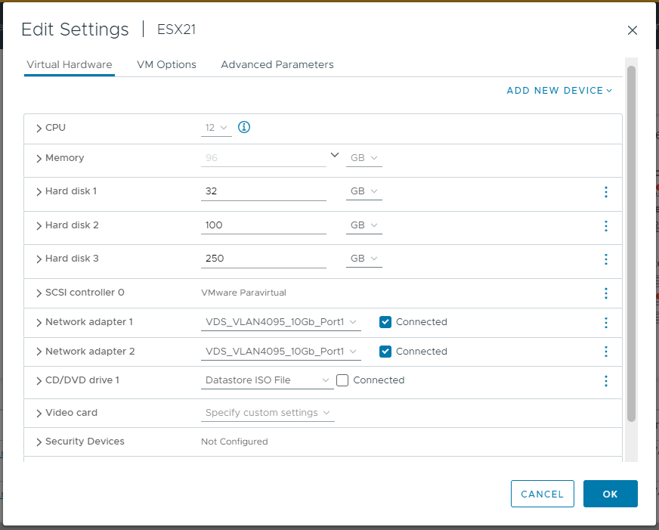
Setting up a test environment

Slide 28
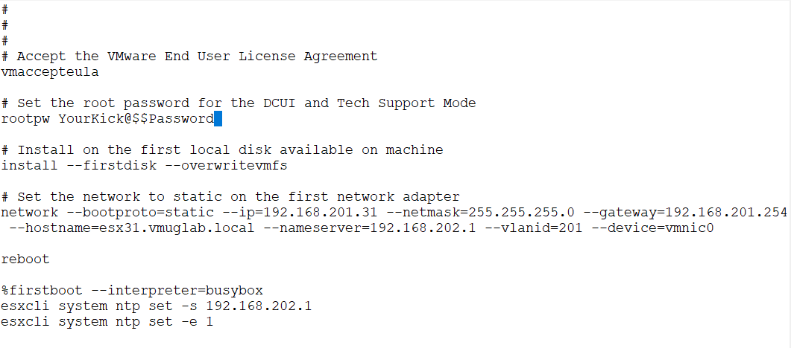
Creating Nested ESXi Boot Media
mount -o loop VMware-VMvisor-Installer-8.0U2-22380479.x86_64.iso /esxi_cdrom_mount
Custom Kickstart
/KS.CFG on the
Install media

Slide 29
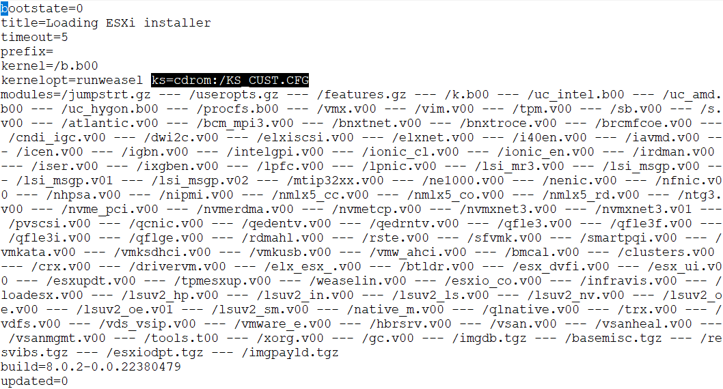
Reference custom
Kickstart file in
/efi/boot/boot.cfg
(Highlighted text) ks=cdrom:/KS_CUST.CFG
Generate custom ISO’s
SCP the ISO’s to your host datastore
genisoimage -relaxed-filenames -J -R -o /ESX21_vSphere8U2.iso -b isolinux.bin -c BOOT.CAT -no-emul-boot -boot-load-size 4 -boot-info-table -eltorito-alt-boot -e efiboot.img –no-emul-boot /esxi_cdrom
genisoimage -relaxed-filenames -J -R -o /ESX22_vSphere8U2.iso -b isolinux.bin -c BOOT.CAT -no-emul-boot -boot-load-size 4 -boot-info-table -eltorito-alt-boot -e efiboot.img –no-emul-boot /esxi_cdrom
genisoimage -relaxed-filenames -J -R -o /ESX23_vSphere8U2.iso -b isolinux.bin -c BOOT.CAT -no-emul-boot -boot-load-size 4 -boot-info-table -eltorito-alt-boot -e efiboot.img –no-emul-boot /esxi_cdrom
genisoimage -relaxed-filenames -J -R -o /ESX24_vSphere8U2.iso -b isolinux.bin -c BOOT.CAT -no-emul-boot -boot-load-size 4 -boot-info-table -eltorito-alt-boot -e efiboot.img –no-emul-boot /esxi_cdrom
scp /ESX21_vSphere8U2.iso root@esx5.vmatt.net:/vmfs/volumes/65d986b8-09d9d051-0b87-1402ec93dae8/ISO/.
scp /ESX22_vSphere8U2.iso root@esx5.vmatt.net:/vmfs/volumes/65d986b8-09d9d051-0b87-1402ec93dae8/ISO/.
scp /ESX23_vSphere8U2.iso root@esx5.vmatt.net:/vmfs/volumes/65d986b8-09d9d051-0b87-1402ec93dae8/ISO/.
scp /ESX24_vSphere8U2.iso root@esx5.vmatt.net:/vmfs/volumes/65d986b8-09d9d051-0b87-1402ec93dae8/ISO/.

Slide 30
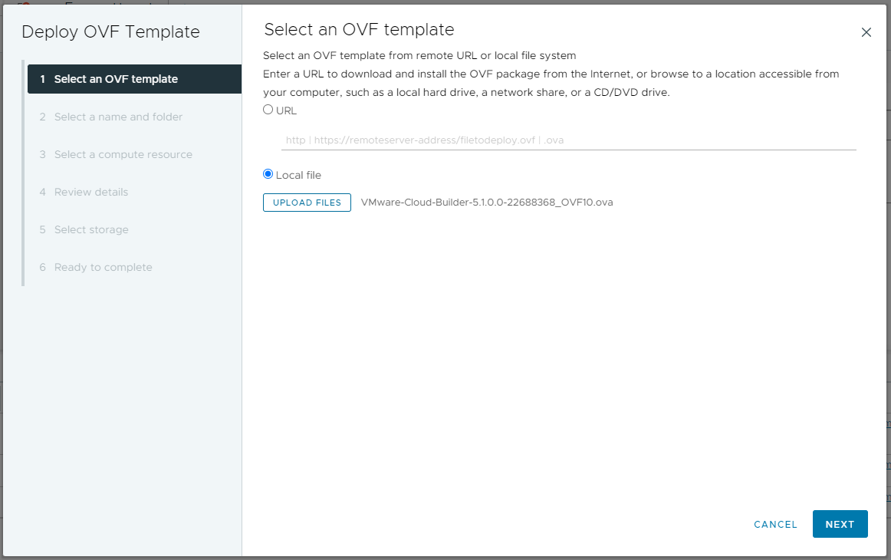
Deploy Cloud Builder Appliance

Slide 31
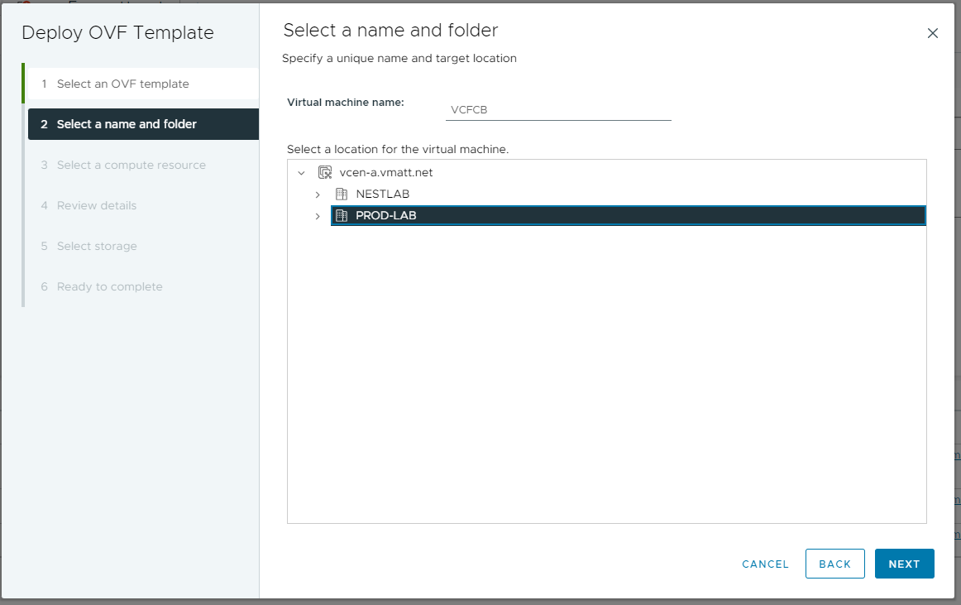

Slide 32
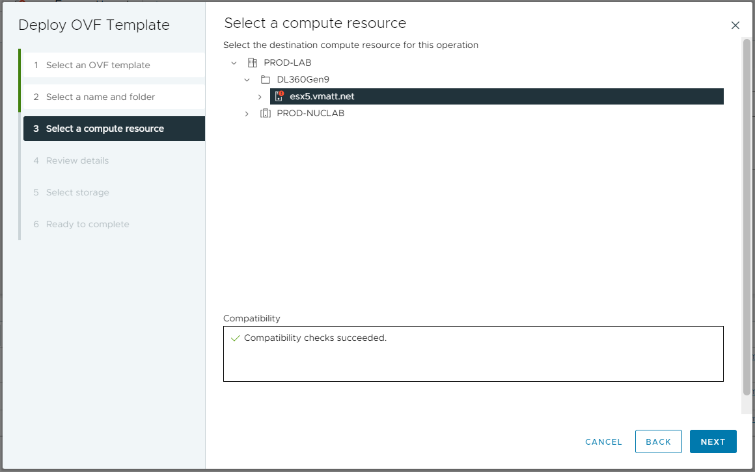

Slide 33
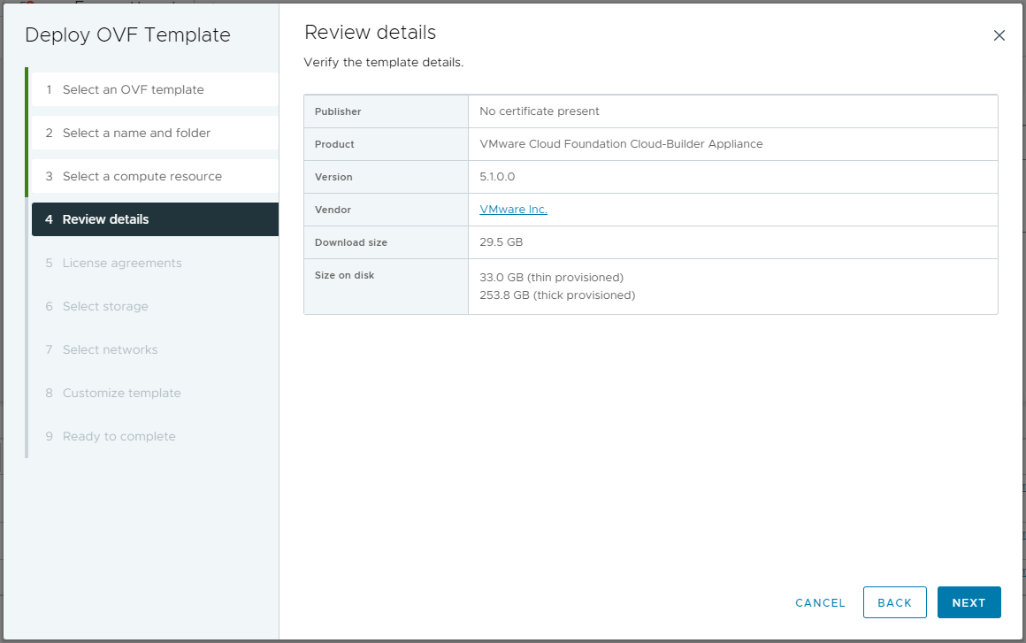

Slide 34
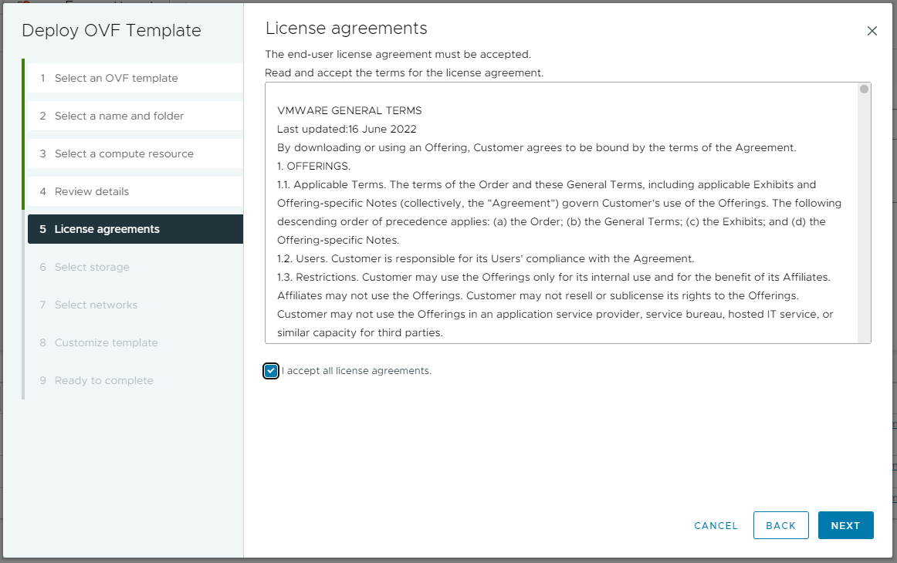

Slide 35
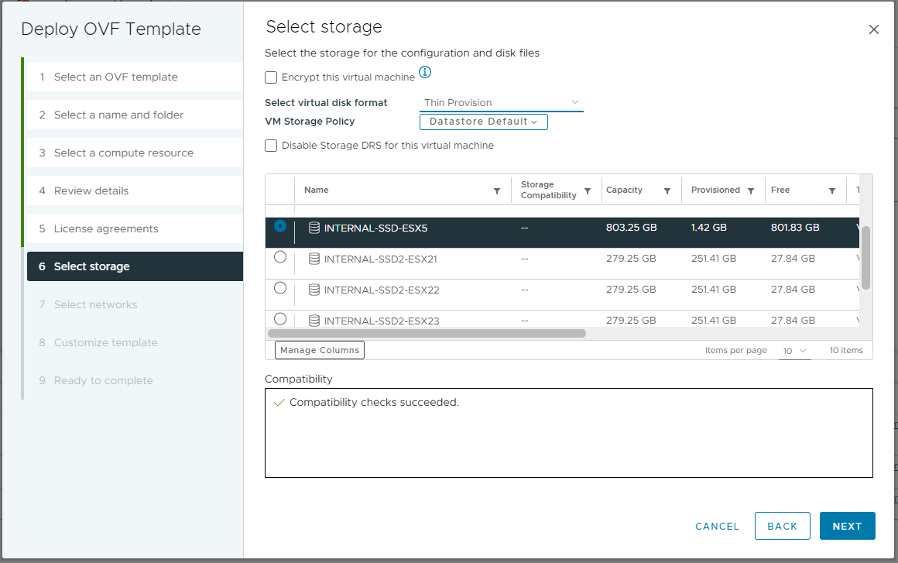
CHOOSE THIN IN A LAB
Environment to save space

Slide 36
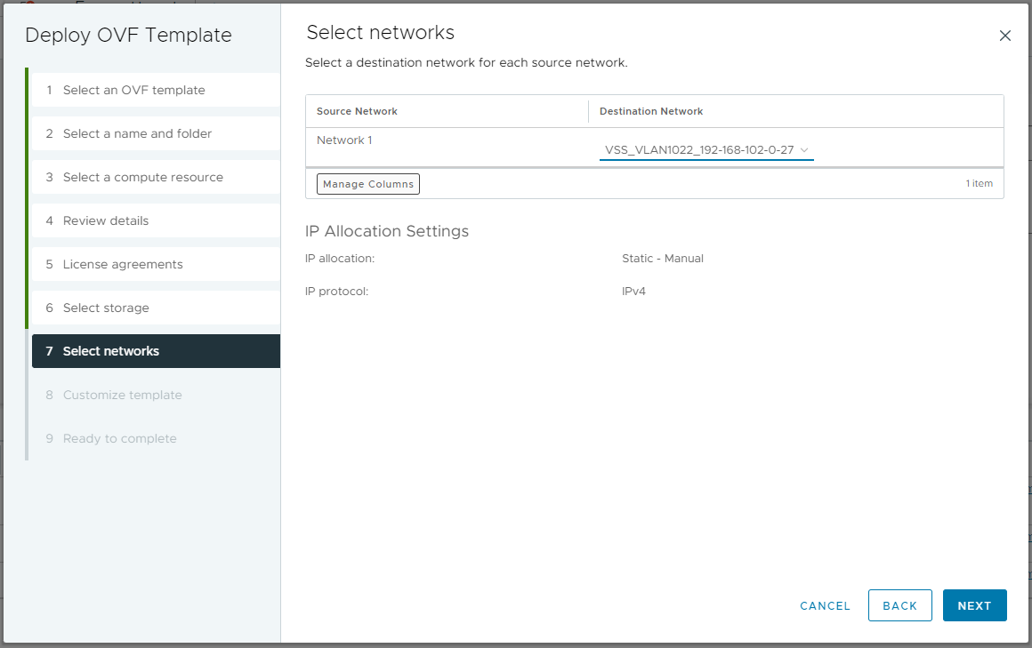

Slide 37
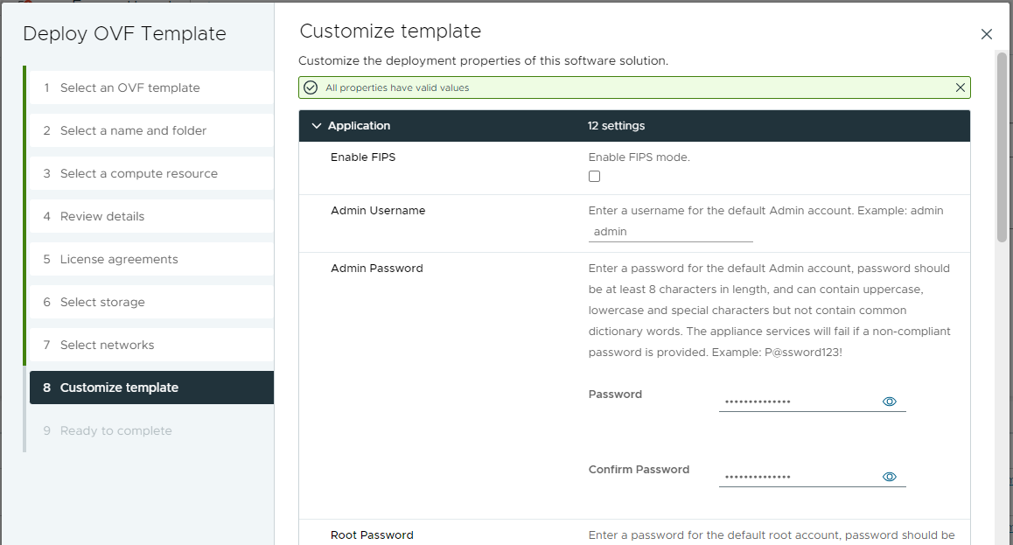
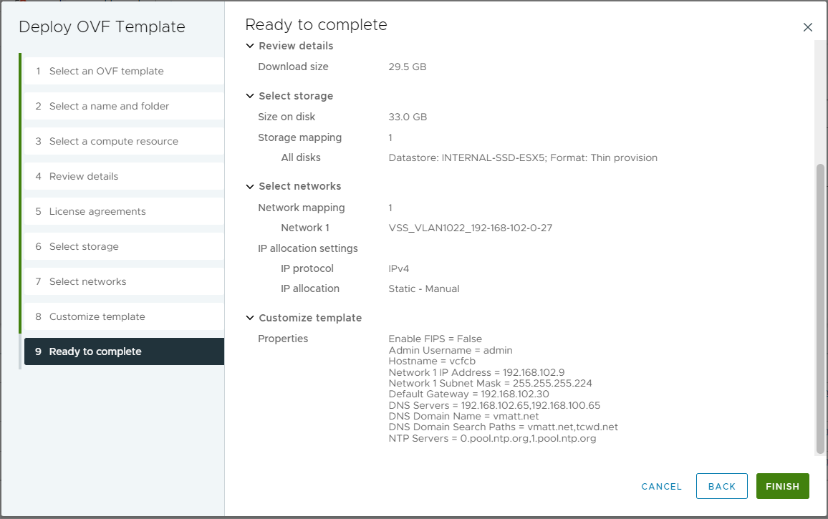
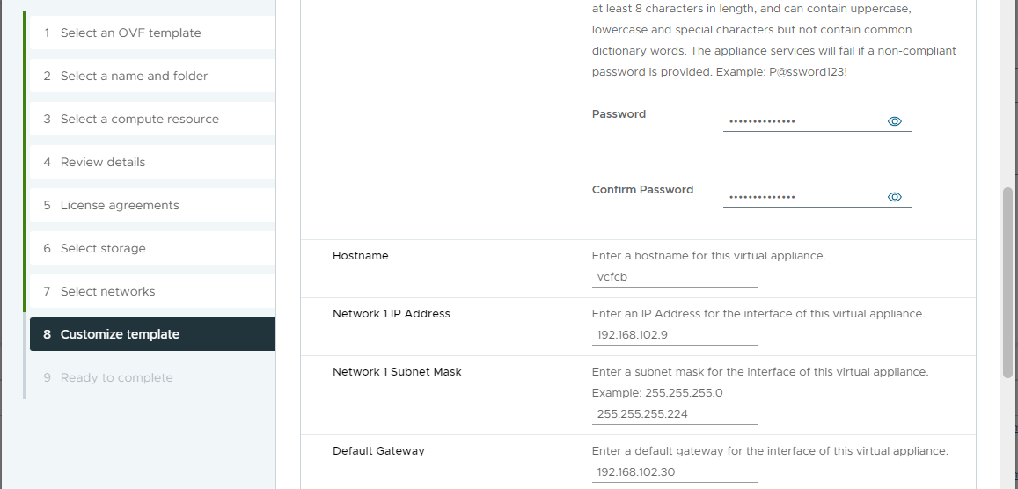
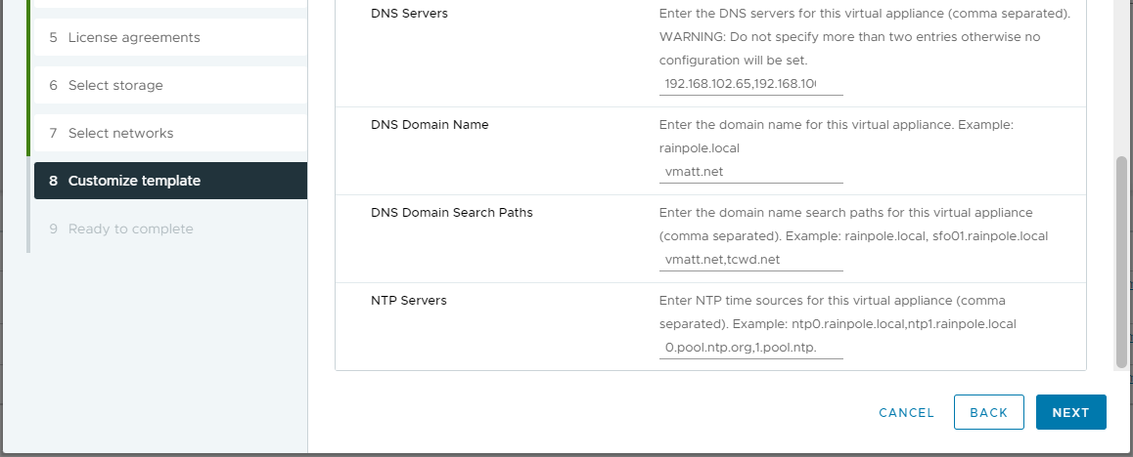
PROTIP: Before you power on the Cloud Builder appliance
Create a snapshot to be able to restart the bringup easily

Slide 38
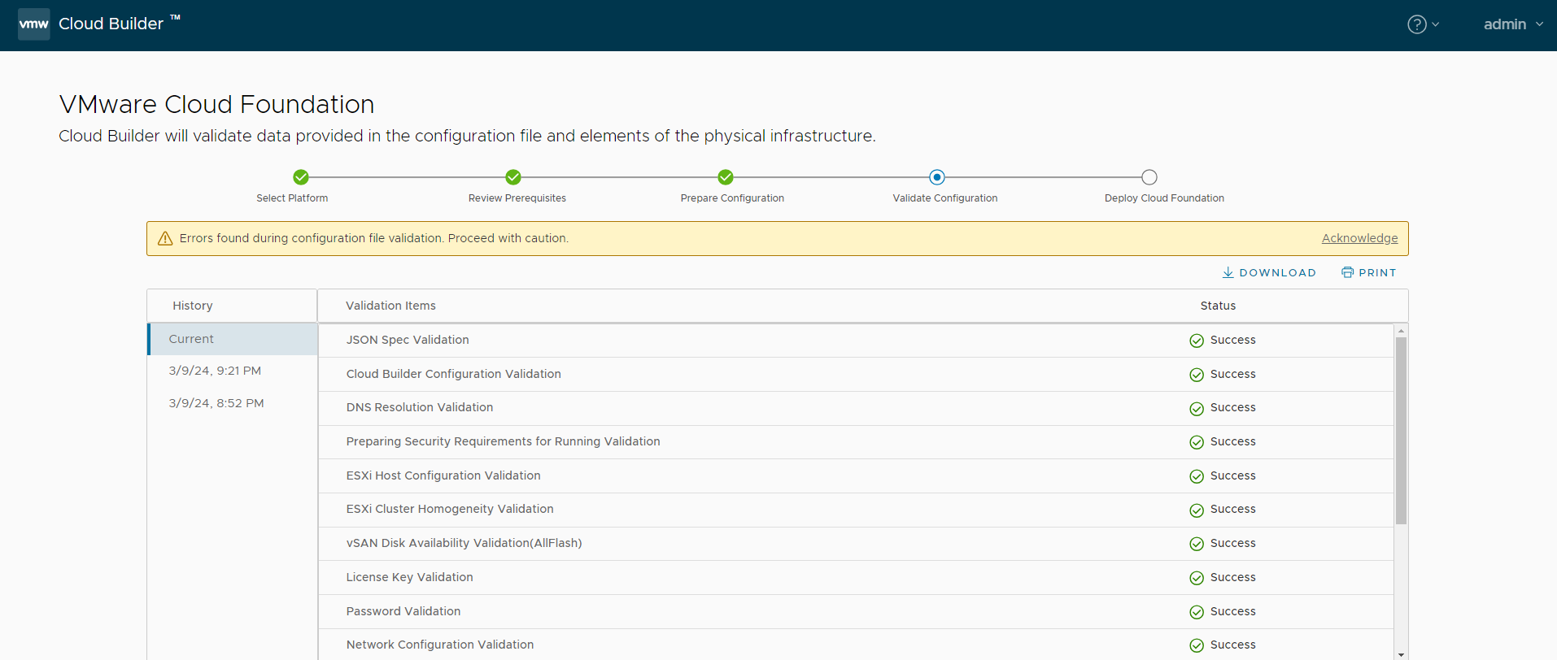
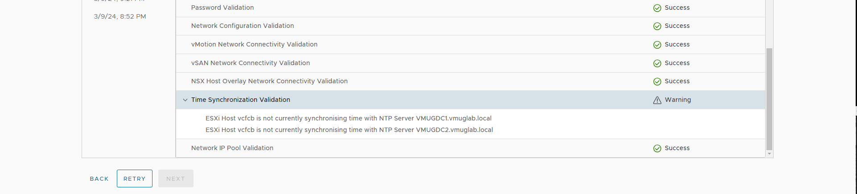


Slide 39
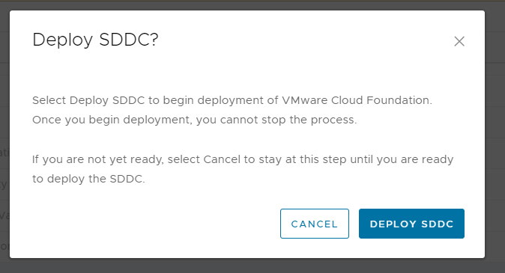

Slide 40
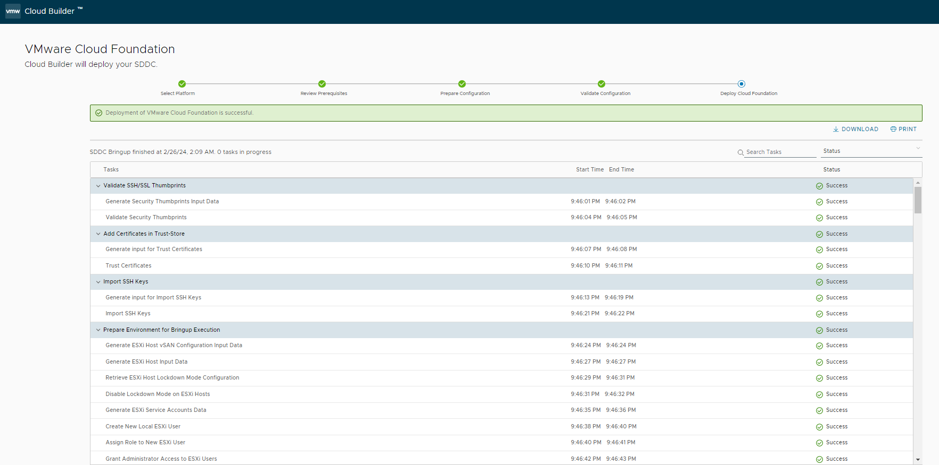

Slide 41
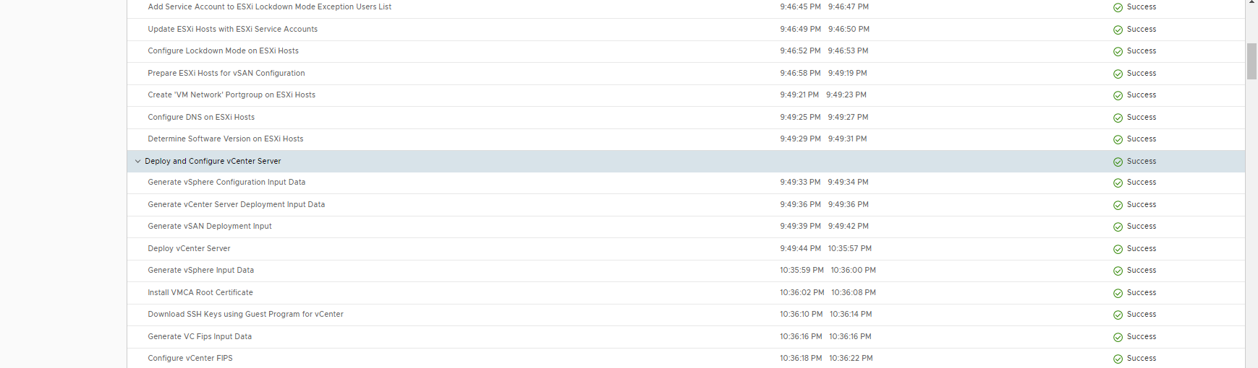
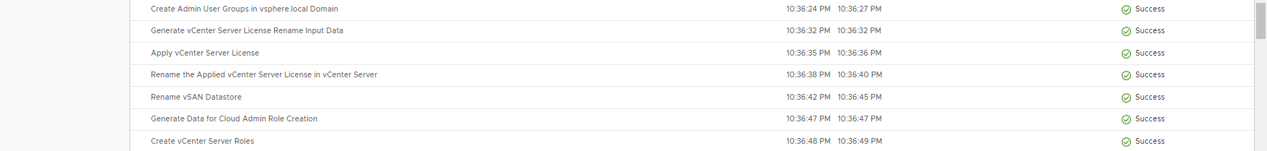

Slide 42
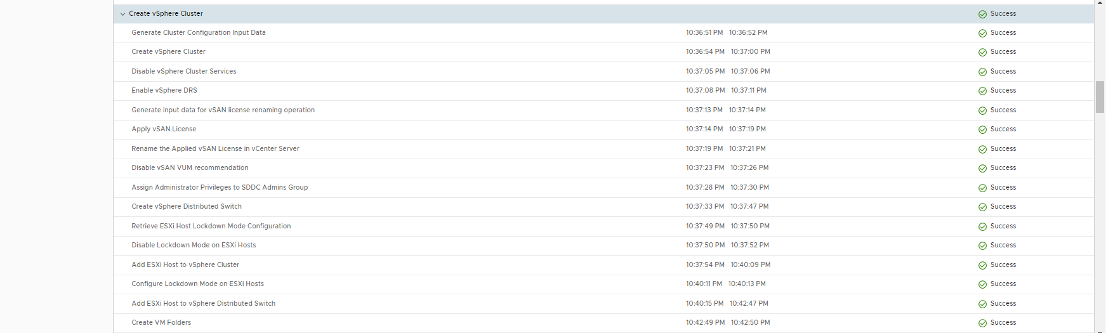

Slide 43
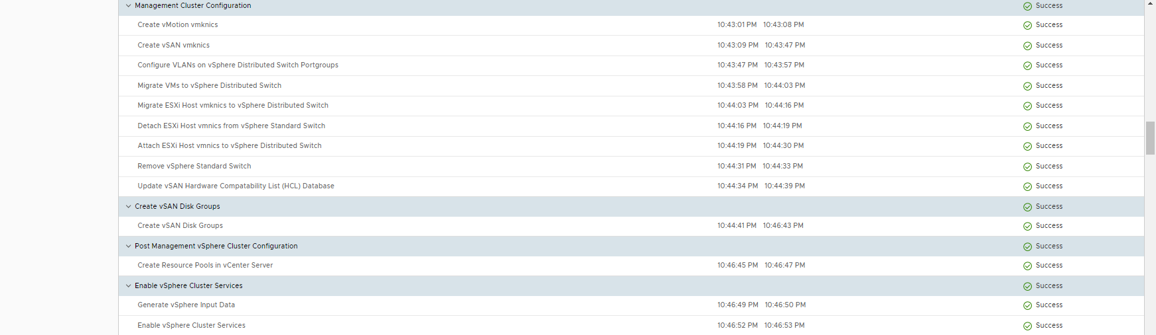
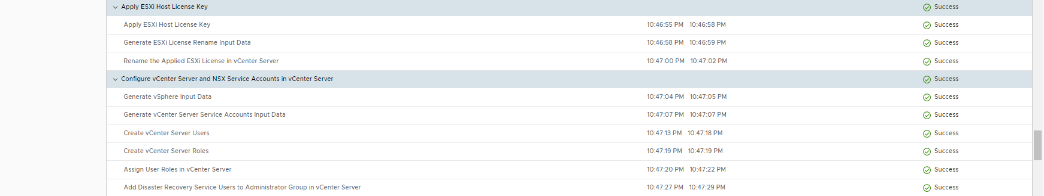

Slide 44
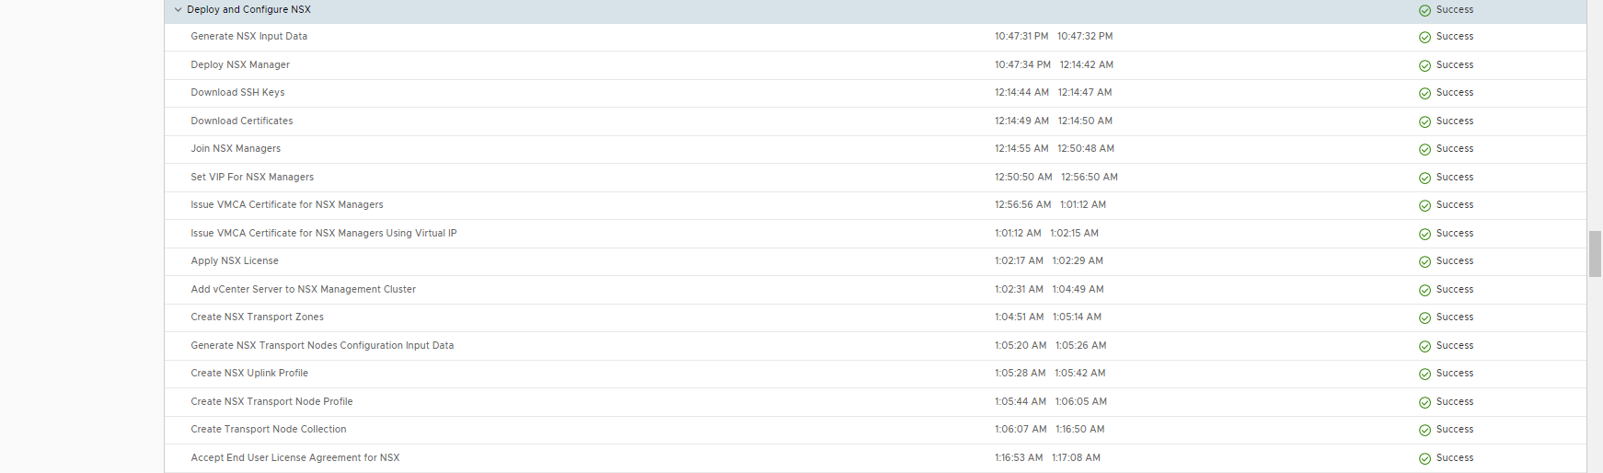
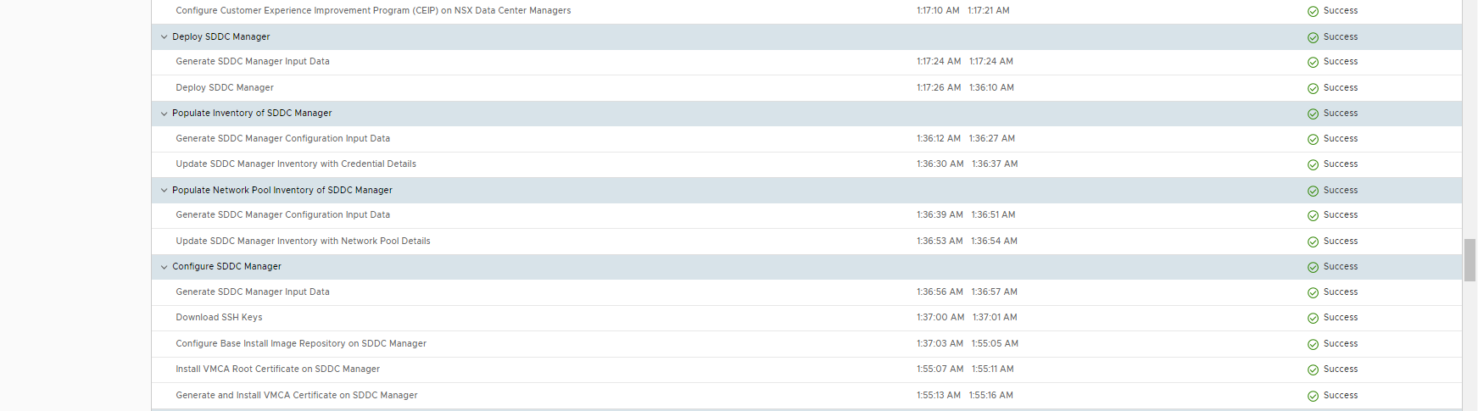

Slide 45
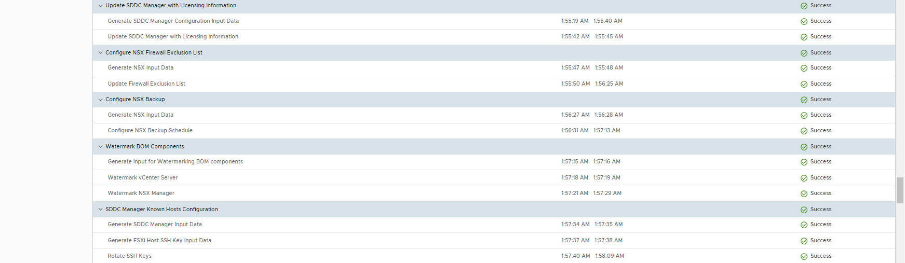
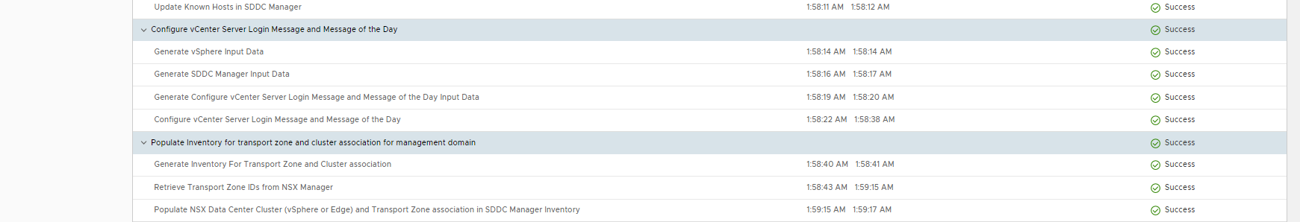

Slide 46
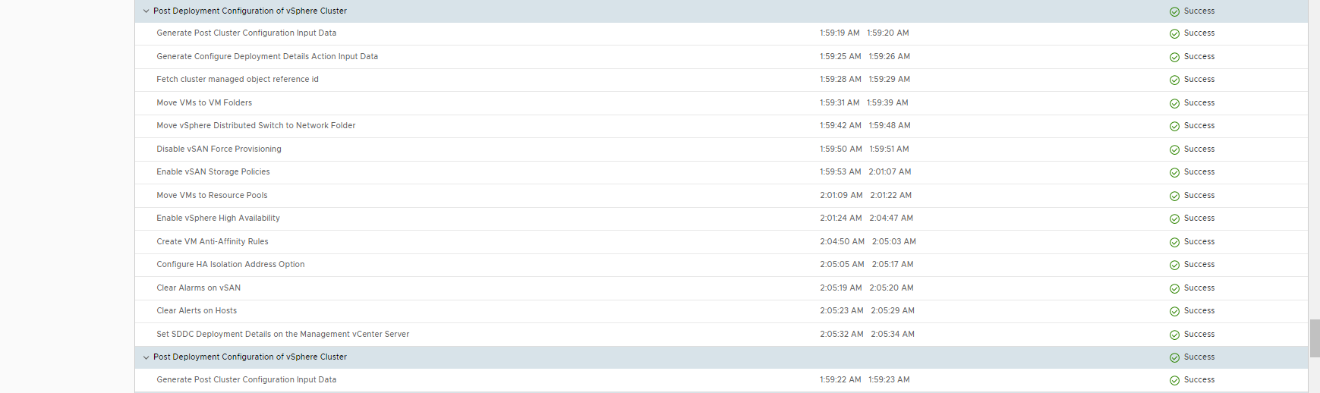
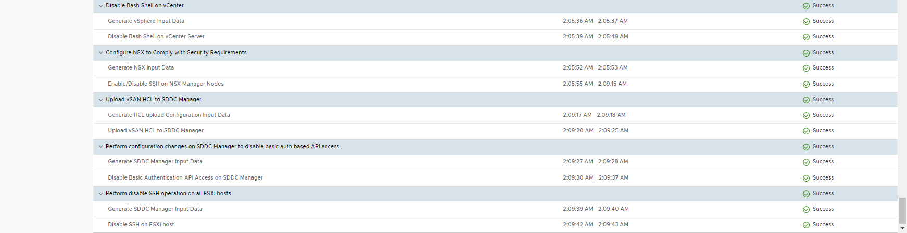

Slide 48
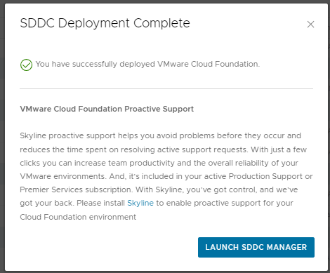
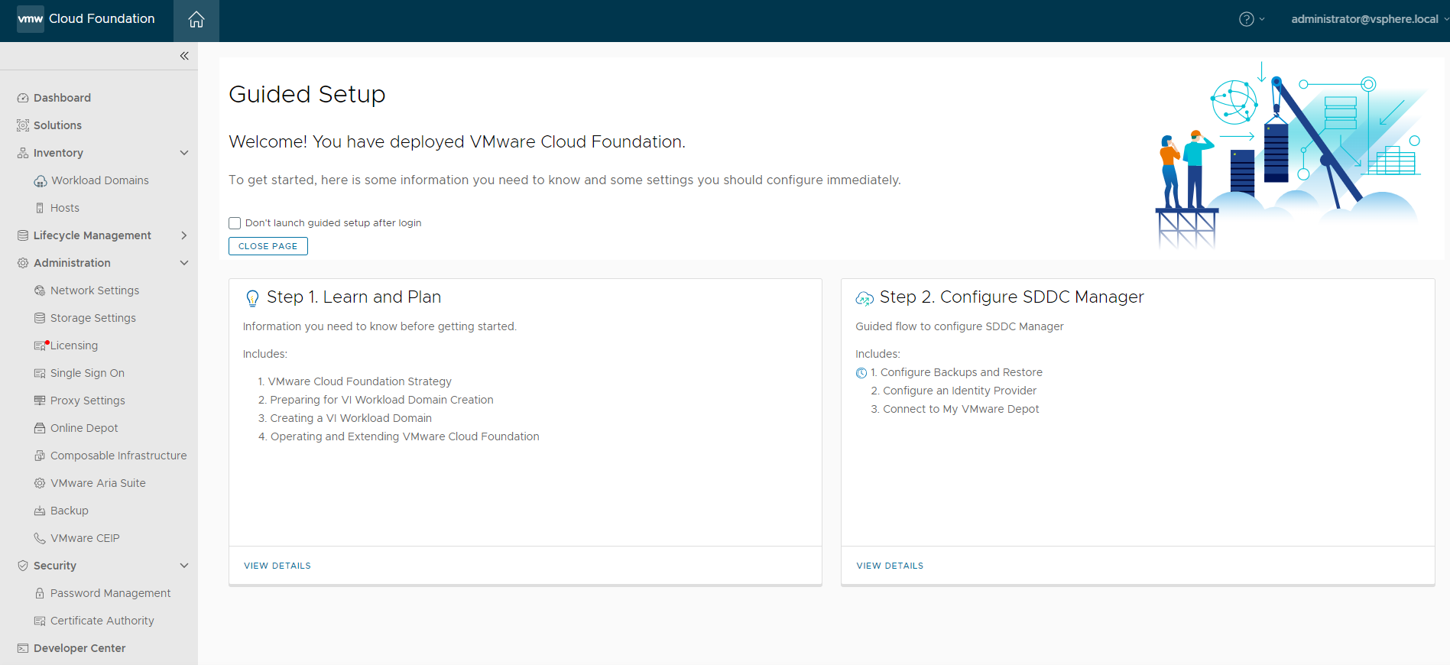
Will take between 4-10 hours
Depending on your infrastructure

Slide 49
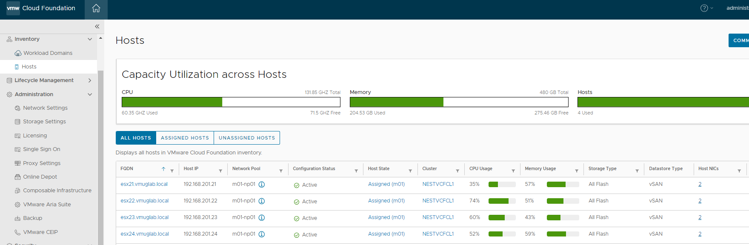
Log in to SDDC Manager for a glimpse of what you have built!

Slide 50
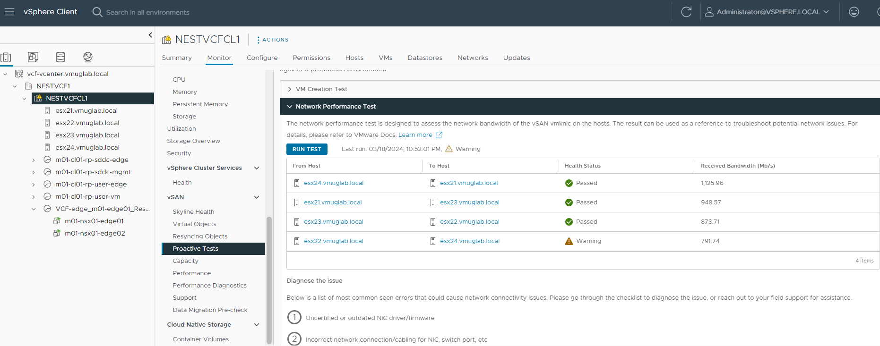
Log in to the Management Domain’s vCenter Server

Slide 51
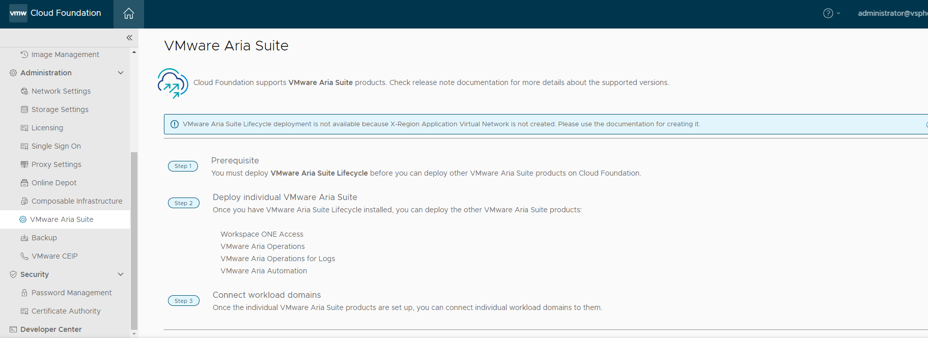

Slide 52
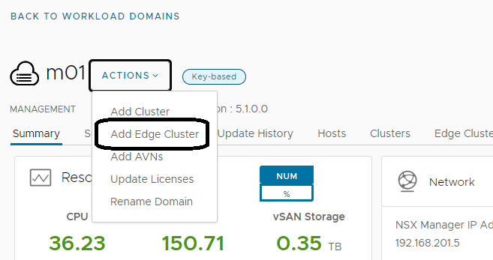
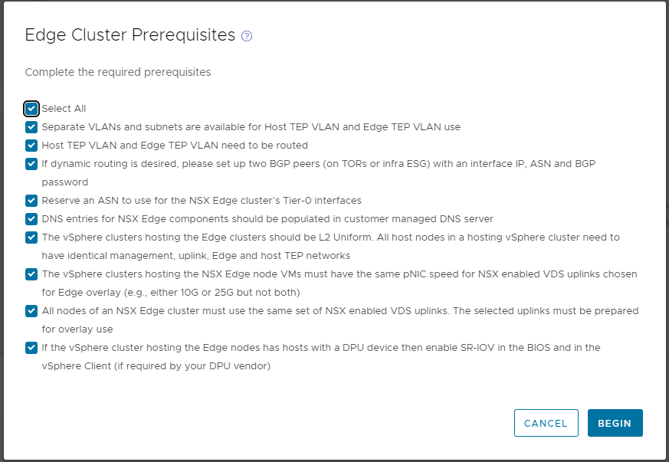

Slide 53
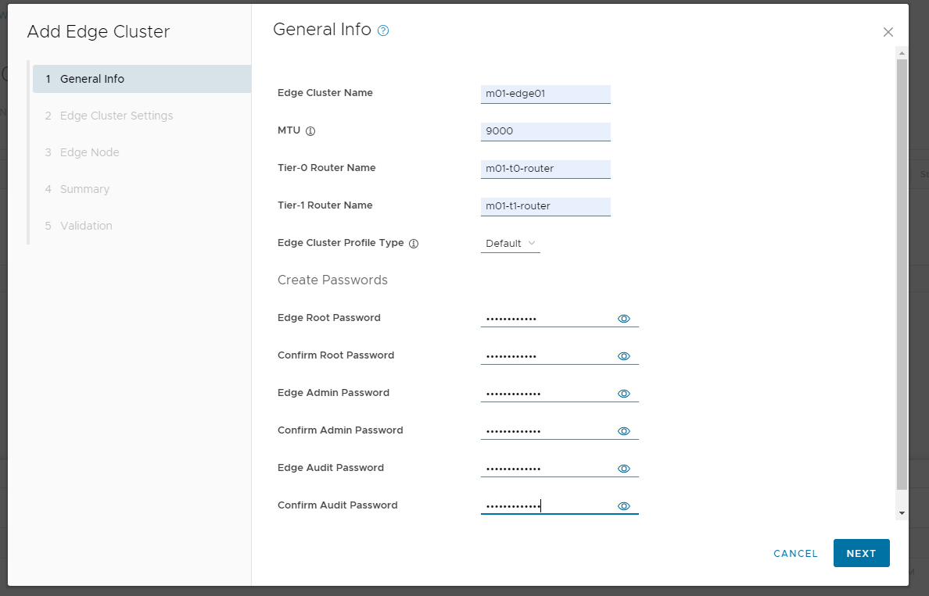

Slide 55
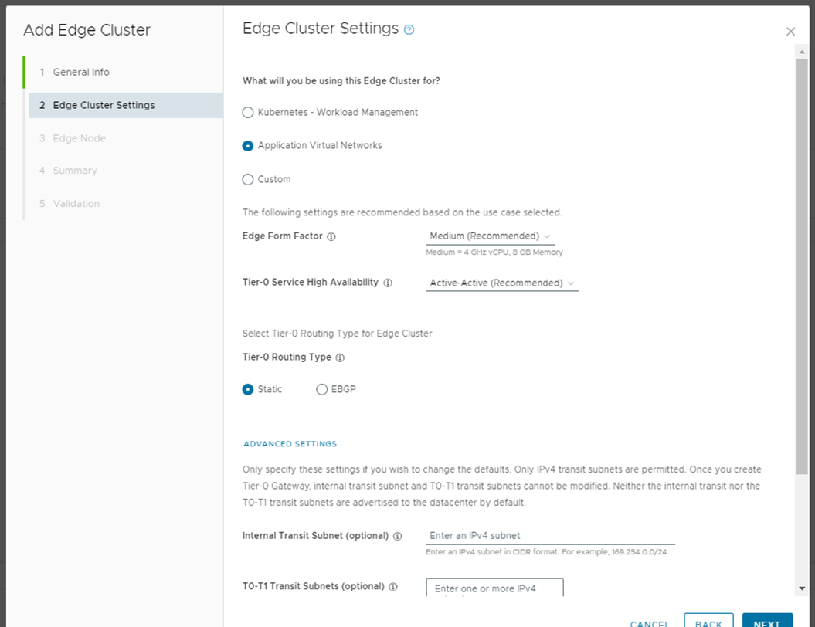

Slide 56
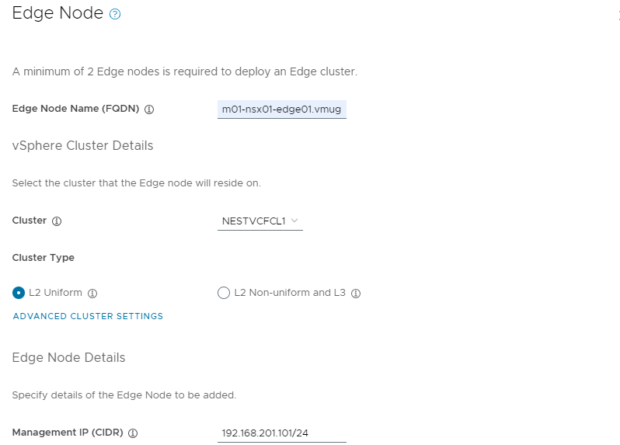

Slide 57
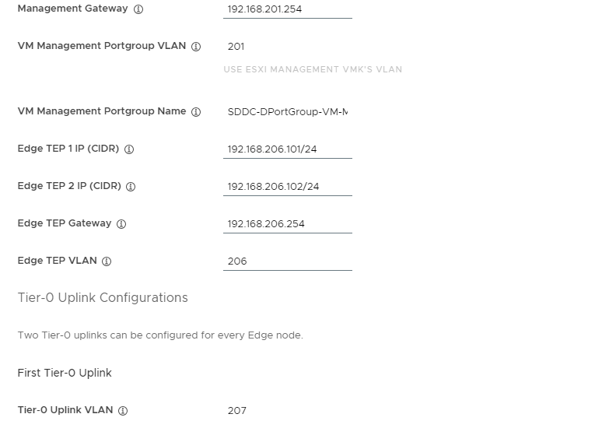

Slide 58



Slide 59


Slide 60


Slide 61


Slide 62


Slide 63

https://captainvops.com/2023/10/06/vmware-cloud-foundation-sddc-manager-day-1-configurations-configure-certificate-authority/

Slide 64

https://captainvops.com/2023/10/06/vmware-cloud-foundation-sddc-manager-day-1-configurations-configure-certificate-authority/

Slide 65


Slide 66


Slide 67

See the importance of having
DNS fully functional (forward
And reverse)
Validation pre-checks can fail
This error was due to a typo in
DNS.

Slide 68


Slide 69


View from vCenter Point-of-View – Deploying an Edge Cluster Node

Slide 70


First – Edge Cluster Node 2 deploys, and then Edge Cluster Node 1 – Shows activating until cluster creation completes

Slide 71


Took about 2 hours to come active

Slide 72


Slide 73


Slide 74




Slide 75



Slide 76

Completed AVN

Slide 77

Let’s add a host
To our management
Cluster in VCF
Deploy a VM with
The same specs
As the other four
Hosts in the
Management
Domain
12 vCPU
96GB RAM
32GB Boot Disk
100GB Cache Disk
250GB Capacity Disk

Slide 78

CLICK COMMISSION HOSTS →

Slide 79


Slide 80


Slide 81

Choose if you want
The host to provide
Storage to vSAN or
If it is going to be a
Compute-only node

Slide 82


Slide 83


Slide 84


Slide 85


Slide 86


Slide 87


Slide 88


Slide 89


1.
2.
4.
3.

Slide 90


Slide 91


Slide 92



Slide 93


Slide 94


Slide 95


Slide 96


Slide 97


Slide 98


Slide 99


Slide 100


Slide 101


Slide 102

https://www.virtualbytes.io/vmware-cloud-foundation-4-4-0-offline-bundle-walkthrough/

Slide 103


Slide 104

https://customerconnect.vmware.com/downloads/details?downloadGroup=VCF5XSUPP_TOOLS&productId=1484

Slide 105


Slide 106

Needed to log off and log back in again for the update bundles to show up (next page)

Slide 107


Slide 108


Slide 109


Slide 110


Slide 111


Slide 112


Slide 113


Slide 114



Slide 115


Slide 116


Slide 117


Slide 118


Slide 119


Slide 120


Slide 121


Slide 122


Slide 123




Slide 124



Slide 125


Slide 126



Slide 127


Slide 128


Slide 129


Slide 130


Slide 131


Slide 132
If there is time – Live Stuff!
Adding an Identity Source via SDDC Manager
Adding a host to the Management Cluster

Slide 133


Slide 134


Slide 135
https://my-sddc.net/creating-a-vcf-lab-on-top-of-vcd-part-2a-certificates/
Certificates
https://my-sddc.net/vcf-on-vcd-shut-down/
Tips on powering down your VCF environment
William Lam’s Holodeck 2.0 on VCF 5.1 Blog
https://williamlam.com/2023/03/self-contained-automated-vmware-cloud-foundation-vcf-deployment-using-new-vlc-holodeck-toolkit.html

Slide 136
Questions? If not, please:

Slide 137







Elements

